Slide 1
Reproducing DeepWeeds: Weed Classification with Transfer Learning and Grad-CAM Interpretability
Srujan Vaddiparthi
Data Science Co-op @ ITT Goulds Pumps
MS Data Science ‘26 | BE Mech Eng.+Robotics ‘23
Applications of ML for Remote Sensing
IMGS 589
Notes:
Good morning/afternoon everyone.
My name is Srujan Vaddiparthi, and today I’ll be presenting my project on reproducing the DeepWeeds classification pipeline using transfer learning and Grad-CAM interpretability.
The goal of this work was to rebuild the DeepWeeds study in a modern PyTorch pipeline, evaluate how well a pretrained ResNet-50 can classify fine-grained weed species, and analyze model behavior using explainability tools.

Slide 2
Agenda
Motivation & Problem Statement
Dataset & Preprocessing
Tech Stack & Hardware
Modeling Approach
Transfer Learning with ResNet-50
Training strategy & augmentations
Results
Accuracy, Confusion Matrix
Class-wise performance
Grad-CAM Interpretability
Correct predictions
Misclassified examples
Discussions & Limitations
Future Work
Conclusion
Notes:
Here is the roadmap for today’s talk.
I’ll start with the motivation - why weed detection matters beyond academic interest.
Then I’ll describe the DeepWeeds dataset and my preprocessing steps, followed by the modeling approach using transfer learning.
We’ll look at the training strategy, the classification results, Grad-CAM visualizations, and finally, limitations and future directions.

Slide 3
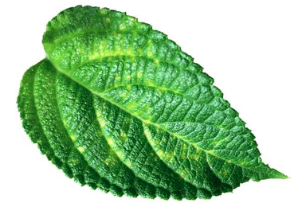
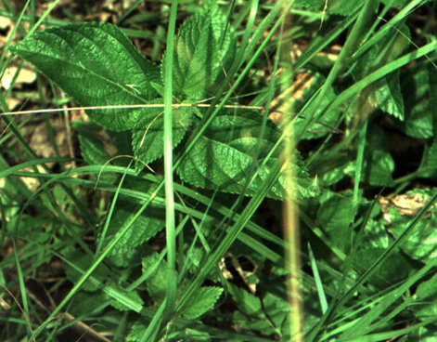
Motivation: Why Weed Detection?
Invasive weeds cause ecological and agricultural damage.
DeepWeeds(Olsen, S. R. (2019)) dataset is a strong benchmark for weed-classification.
Need models that are accurate and interpretable.
A reliable AI system for weed identification:
Reduce water waste,
Reduce unnecessary chemical use,
Make lawn maintenance more affordable and sustainable.
Interpretability matters for:
Safety (especially with robotics),
Environmental decision-making,
Trust and transparency in ecological applications
How does this fit into a remote sensing course? Techniques here (classification + interpretability) directly transfer to UAV and drone- based vegetation mapping, crop monitoring, and ecological surveying.
Lantana Camara
Notes:
Invasive weeds create major ecological, agricultural, and economic damage worldwide.
For example, Lantana camara is recognized by the IUCN as one of the world’s worst invasive species. It forms dense thickets, displaces native vegetation, and is toxic to livestock. Similarly, Parthenium hysterophorus is classified globally as a highly noxious weed, causing skin allergies, respiratory issues, livestock poisoning, and agricultural losses across India, Australia, and the Americas.
The DeepWeeds dataset provides a challenging, real-world benchmark because these species are visually similar, appear in natural clutter, and can vary widely in lighting and growth stages.
But this problem is not limited to large rangelands.
Even in the U.S., homeowners spend billions annually on weed control. Many invasive weeds compete with grass for water, degrade soil quality, and increase irrigation and maintenance costs. Today, most control is either manual or relies on broad chemical spraying.
A reliable AI-based weed identification system could make weed management:
– more water-efficient,
– less chemical-intensive, and
– more affordable for everyday environments.
Beyond classification, interpretability is crucial.
Whether these models are used in robotics, drones, lawn-care automation, or environmental monitoring, we need to know why the model made a decision, not just what it predicted.
That is why this project focuses not only on reproducing accurate classification but also on interpretable classification via Grad-CAM, which gives insight into what parts of the plant the model actually uses to make decisions.
How this fits into remote sensing course?
“Although this project uses ground-level RGB images, the same ideas — species identification, spatial reasoning, interpretability, and model generalization — directly extend to remote sensing tasks such as crop monitoring, invasive species mapping, forestry analysis, and even disaster assessment. Weed detection is simply a controlled, grounded case study that lets me practice the exact skills used in satellite, UAV, and hyperspectral pipelines.”

Slide 4
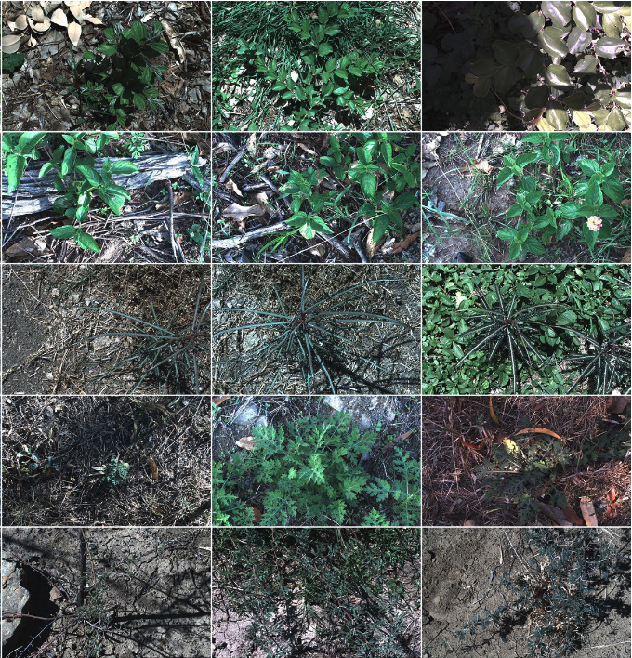
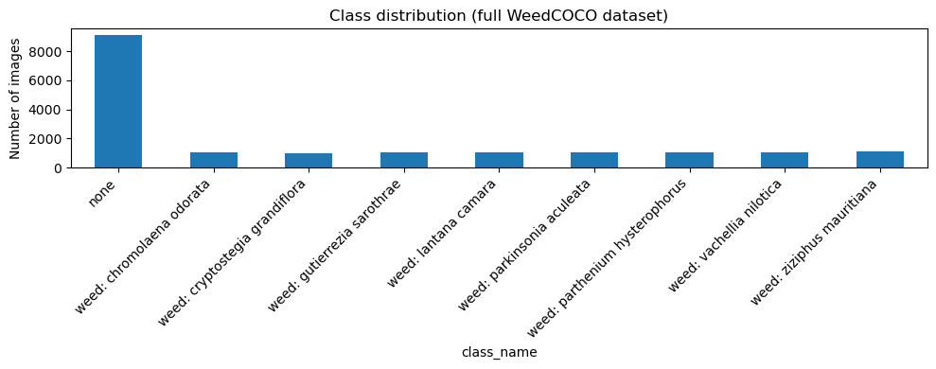
Dataset
Source: Weed-AI repository
17,492 RGB images. [image folder].
8 weed species + “none” class. [weedcoco.json annotation file (class labels + metadata)].
Intra-class variation: lighting changes, growth stages, cluttered vegetation backgrounds.
Notes:
Invasive weeds create major ecological, agricultural, and economic damage worldwide.
For example, Lantana camara is recognized by the IUCN as one of the world’s worst invasive species. It forms dense thickets, displaces native vegetation, and is toxic to livestock. Similarly, Parthenium hysterophorus is classified globally as a highly noxious weed, causing skin allergies, respiratory issues, livestock poisoning, and agricultural losses across India, Australia, and the Americas.
The DeepWeeds dataset provides a challenging, real-world benchmark because these species are visually similar, appear in natural clutter, and can vary widely in lighting and growth stages.
But this problem is not limited to large rangelands.
Even in the U.S., homeowners spend billions annually on weed control. Many invasive weeds compete with grass for water, degrade soil quality, and increase irrigation and maintenance costs. Today, most control is either manual or relies on broad chemical spraying.
A reliable AI-based weed identification system could make weed management:
– more water-efficient,
– less chemical-intensive, and
– more affordable for everyday environments.
Beyond classification, interpretability is crucial.
Whether these models are used in robotics, drones, lawn-care automation, or environmental monitoring, we need to know why the model made a decision, not just what it predicted.
That is why this project focuses not only on reproducing accurate classification but also on interpretable classification via Grad-CAM, which gives insight into what parts of the plant the model actually uses to make decisions.
How this fits into remote sensing course?
“Although this project uses ground-level RGB images, the same ideas — species identification, spatial reasoning, interpretability, and model generalization — directly extend to remote sensing tasks such as crop monitoring, invasive species mapping, forestry analysis, and even disaster assessment. Weed detection is simply a controlled, grounded case study that lets me practice the exact skills used in satellite, UAV, and hyperspectral pipelines.”

Slide 5
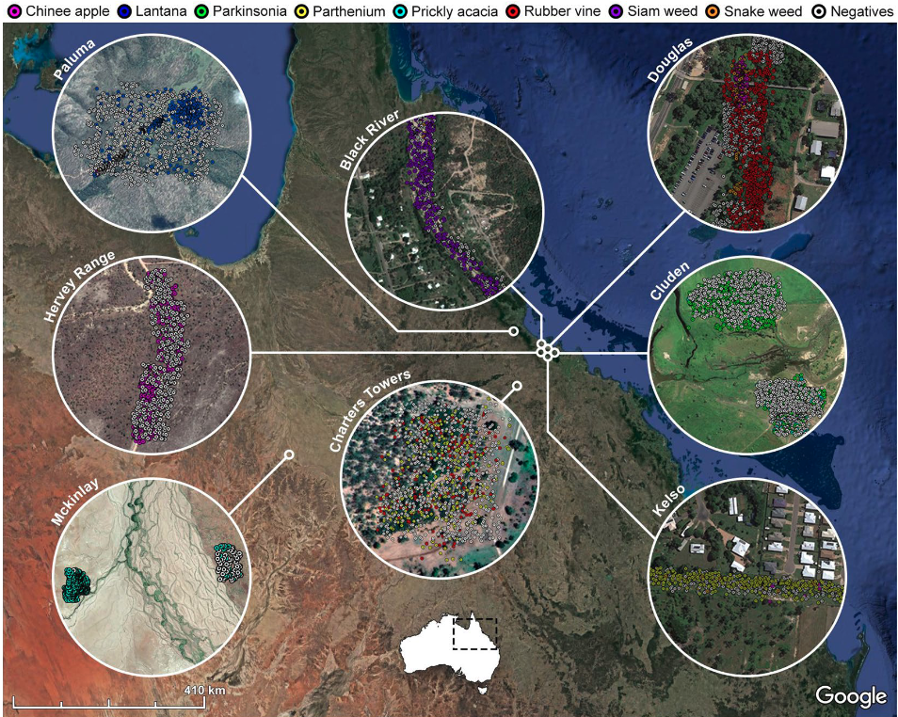
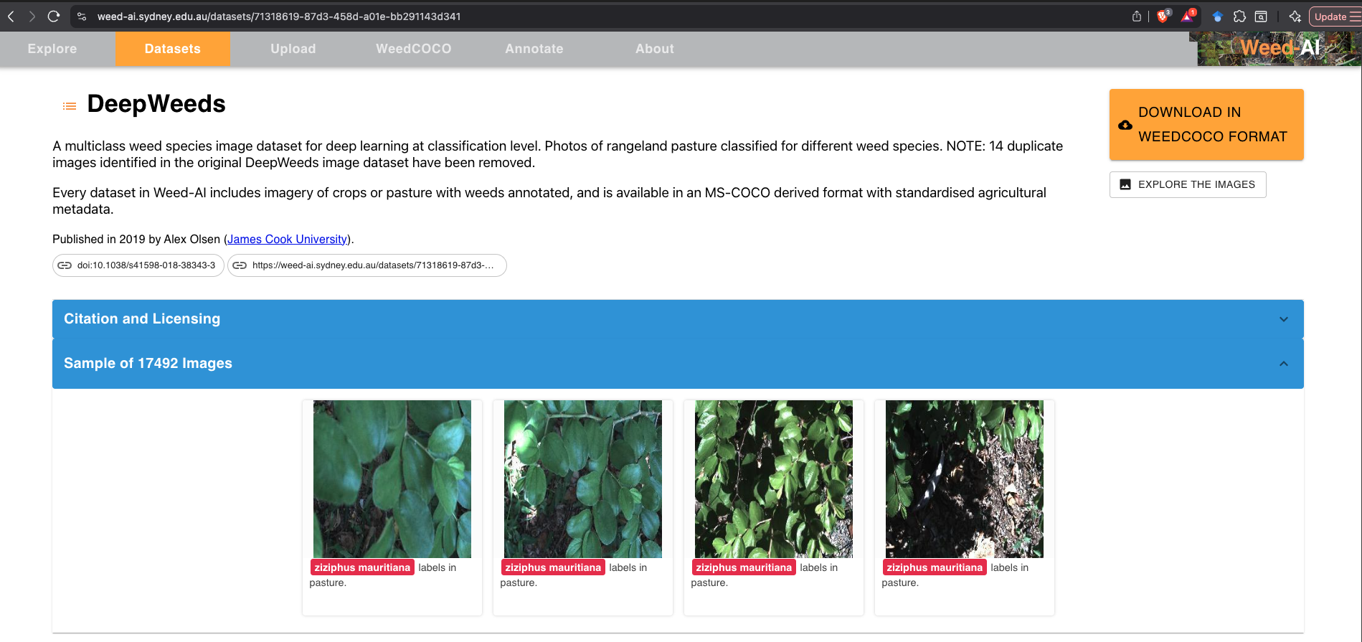
Dataset
Weed-AI website: DeepWeeds dataset in MSCOCO format.
Geographical Distribution of weeds across northern Australia
Image from DeepWeeds paper (Olsen 2019).
Notes:
Invasive weeds create major ecological, agricultural, and economic damage worldwide.
For example, Lantana camara is recognized by the IUCN as one of the world’s worst invasive species. It forms dense thickets, displaces native vegetation, and is toxic to livestock. Similarly, Parthenium hysterophorus is classified globally as a highly noxious weed, causing skin allergies, respiratory issues, livestock poisoning, and agricultural losses across India, Australia, and the Americas.
The DeepWeeds dataset provides a challenging, real-world benchmark because these species are visually similar, appear in natural clutter, and can vary widely in lighting and growth stages.
But this problem is not limited to large rangelands.
Even in the U.S., homeowners spend billions annually on weed control. Many invasive weeds compete with grass for water, degrade soil quality, and increase irrigation and maintenance costs. Today, most control is either manual or relies on broad chemical spraying.
A reliable AI-based weed identification system could make weed management:
– more water-efficient,
– less chemical-intensive, and
– more affordable for everyday environments.
Beyond classification, interpretability is crucial.
Whether these models are used in robotics, drones, lawn-care automation, or environmental monitoring, we need to know why the model made a decision, not just what it predicted.
That is why this project focuses not only on reproducing accurate classification but also on interpretable classification via Grad-CAM, which gives insight into what parts of the plant the model actually uses to make decisions.
How this fits into remote sensing course?
“Although this project uses ground-level RGB images, the same ideas — species identification, spatial reasoning, interpretability, and model generalization — directly extend to remote sensing tasks such as crop monitoring, invasive species mapping, forestry analysis, and even disaster assessment. Weed detection is simply a controlled, grounded case study that lets me practice the exact skills used in satellite, UAV, and hyperspectral pipelines.”

Slide 6
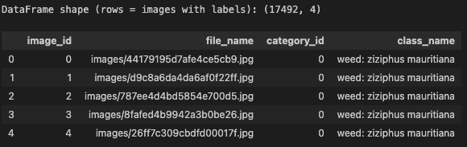
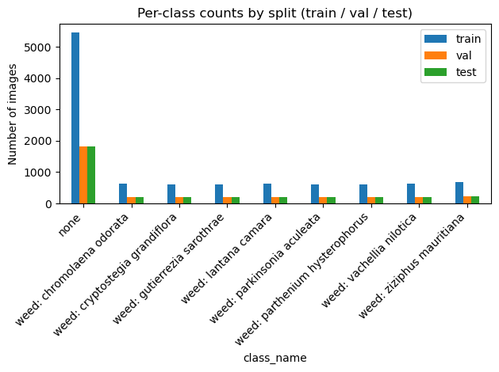
Preprocessing
Converted WeedCOCO JSON → DataFrame.
Performed a stratified split (60/20/20) to preserve class balance.
Standardized using ImageNet normalization (μ, σ) for Transfer Learning. IMAGENET_MEAN = [0.485, 0.456, 0.406]
IMAGENET_STD = [0.229, 0.224, 0.225]
Notes:
Invasive weeds create major ecological, agricultural, and economic damage worldwide.
For example, Lantana camara is recognized by the IUCN as one of the world’s worst invasive species. It forms dense thickets, displaces native vegetation, and is toxic to livestock. Similarly, Parthenium hysterophorus is classified globally as a highly noxious weed, causing skin allergies, respiratory issues, livestock poisoning, and agricultural losses across India, Australia, and the Americas.
The DeepWeeds dataset provides a challenging, real-world benchmark because these species are visually similar, appear in natural clutter, and can vary widely in lighting and growth stages.
But this problem is not limited to large rangelands.
Even in the U.S., homeowners spend billions annually on weed control. Many invasive weeds compete with grass for water, degrade soil quality, and increase irrigation and maintenance costs. Today, most control is either manual or relies on broad chemical spraying.
A reliable AI-based weed identification system could make weed management:
– more water-efficient,
– less chemical-intensive, and
– more affordable for everyday environments.
Beyond classification, interpretability is crucial.
Whether these models are used in robotics, drones, lawn-care automation, or environmental monitoring, we need to know why the model made a decision, not just what it predicted.
That is why this project focuses not only on reproducing accurate classification but also on interpretable classification via Grad-CAM, which gives insight into what parts of the plant the model actually uses to make decisions.
How this fits into remote sensing course?
“Although this project uses ground-level RGB images, the same ideas — species identification, spatial reasoning, interpretability, and model generalization — directly extend to remote sensing tasks such as crop monitoring, invasive species mapping, forestry analysis, and even disaster assessment. Weed detection is simply a controlled, grounded case study that lets me practice the exact skills used in satellite, UAV, and hyperspectral pipelines.” Preprocessing: For the training set, I used lightweight augmentations — random resized crop, horizontal flip, and mild color jitter — to help the model generalize to cluttered field conditions. The validation and test sets only used resizing and normalization so that the evaluation remains clean.

Slide 7
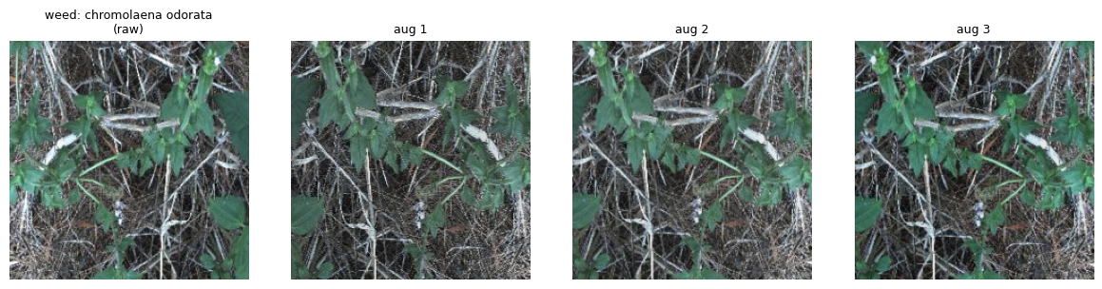
Preprocessing
Applied targeted augmentations for training:
Resize + RandomResizedCrop (224×224) [aug1]
Horizontal Flip [aug2]
Color jitter [aug3]
No heavy augmentation on Validation & Test Only Resize + Normalization.
Notes:
Invasive weeds create major ecological, agricultural, and economic damage worldwide.
For example, Lantana camara is recognized by the IUCN as one of the world’s worst invasive species. It forms dense thickets, displaces native vegetation, and is toxic to livestock. Similarly, Parthenium hysterophorus is classified globally as a highly noxious weed, causing skin allergies, respiratory issues, livestock poisoning, and agricultural losses across India, Australia, and the Americas.
The DeepWeeds dataset provides a challenging, real-world benchmark because these species are visually similar, appear in natural clutter, and can vary widely in lighting and growth stages.
But this problem is not limited to large rangelands.
Even in the U.S., homeowners spend billions annually on weed control. Many invasive weeds compete with grass for water, degrade soil quality, and increase irrigation and maintenance costs. Today, most control is either manual or relies on broad chemical spraying.
A reliable AI-based weed identification system could make weed management:
– more water-efficient,
– less chemical-intensive, and
– more affordable for everyday environments.
Beyond classification, interpretability is crucial.
Whether these models are used in robotics, drones, lawn-care automation, or environmental monitoring, we need to know why the model made a decision, not just what it predicted.
That is why this project focuses not only on reproducing accurate classification but also on interpretable classification via Grad-CAM, which gives insight into what parts of the plant the model actually uses to make decisions.
How this fits into remote sensing course?
“Although this project uses ground-level RGB images, the same ideas — species identification, spatial reasoning, interpretability, and model generalization — directly extend to remote sensing tasks such as crop monitoring, invasive species mapping, forestry analysis, and even disaster assessment. Weed detection is simply a controlled, grounded case study that lets me practice the exact skills used in satellite, UAV, and hyperspectral pipelines.” Preprocessing: For the training set, I used lightweight augmentations — random resized crop, horizontal flip, and mild color jitter — to help the model generalize to cluttered field conditions. The validation and test sets only used resizing and normalization so that the evaluation remains clean.

Slide 8
Tech Stack & Hardware
Tech Stack
Python 3.11
PyTorch for training & inference
Torchvision pretrained ResNet-50
NumPy / Pandas for data structuring
Matplotlib for visualization
pytorch-grad-cam for interpretability
scikit-learn for metrics & confusion matrix
Hardware
Apple M1/M2 CPU + MPS acceleration (Mac)
Training time: ~40 minutes for 11 epochs
Batch size: 32
Image size: 224 × 224
Project Structure
Simple WeedCOCO → DataFrame → DataLoader pipeline
Reproducible training loop
Saved model checkpoints & Grad-CAM outputs
Notes:
Invasive weeds create major ecological, agricultural, and economic damage worldwide.
For example, Lantana camara is recognized by the IUCN as one of the world’s worst invasive species. It forms dense thickets, displaces native vegetation, and is toxic to livestock. Similarly, Parthenium hysterophorus is classified globally as a highly noxious weed, causing skin allergies, respiratory issues, livestock poisoning, and agricultural losses across India, Australia, and the Americas.
The DeepWeeds dataset provides a challenging, real-world benchmark because these species are visually similar, appear in natural clutter, and can vary widely in lighting and growth stages.
But this problem is not limited to large rangelands.
Even in the U.S., homeowners spend billions annually on weed control. Many invasive weeds compete with grass for water, degrade soil quality, and increase irrigation and maintenance costs. Today, most control is either manual or relies on broad chemical spraying.
A reliable AI-based weed identification system could make weed management:
– more water-efficient,
– less chemical-intensive, and
– more affordable for everyday environments.
Beyond classification, interpretability is crucial.
Whether these models are used in robotics, drones, lawn-care automation, or environmental monitoring, we need to know why the model made a decision, not just what it predicted.
That is why this project focuses not only on reproducing accurate classification but also on interpretable classification via Grad-CAM, which gives insight into what parts of the plant the model actually uses to make decisions.
How this fits into remote sensing course?
“Although this project uses ground-level RGB images, the same ideas — species identification, spatial reasoning, interpretability, and model generalization — directly extend to remote sensing tasks such as crop monitoring, invasive species mapping, forestry analysis, and even disaster assessment. Weed detection is simply a controlled, grounded case study that lets me practice the exact skills used in satellite, UAV, and hyperspectral pipelines.” Preprocessing: For the training set, I used lightweight augmentations — random resized crop, horizontal flip, and mild color jitter — to help the model generalize to cluttered field conditions. The validation and test sets only used resizing and normalization so that the evaluation remains clean.

Slide 9
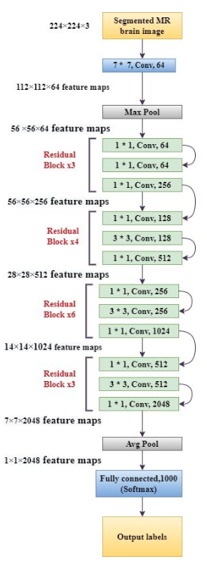
Modeling Approach (Transfer Learning with ResNet-50)
Base architecture: ResNet-50 (pretrained on ImageNet).
Reason for choosing:
strong baseline shown in DeepWeeds paper
ImageNet weights provide robust low-level feature extractors
Modification:
Replaced the final fully connected layer with a 9-output layer.
Why transfer learning?
Training from scratch (as in DeepWeeds) requires 50-100 epochs + large compute.
Using pretrained features allows faster convergence (10-12 epochs).
Reduces overfitting risk on moderate-sized datasets.
What feature extractors already “know”:
Edges, shape, corners
Textures, repeating patterns
Color gradients
What the model learns from weed data:
Leaf morphology, branching patterns, texture, species-specific shape cues.
9-class output layer
models.resnet50(pretrained=True)
Notes:
Invasive weeds create major ecological, agricultural, and economic damage worldwide.
For example, Lantana camara is recognized by the IUCN as one of the world’s worst invasive species. It forms dense thickets, displaces native vegetation, and is toxic to livestock. Similarly, Parthenium hysterophorus is classified globally as a highly noxious weed, causing skin allergies, respiratory issues, livestock poisoning, and agricultural losses across India, Australia, and the Americas.
The DeepWeeds dataset provides a challenging, real-world benchmark because these species are visually similar, appear in natural clutter, and can vary widely in lighting and growth stages.
But this problem is not limited to large rangelands.
Even in the U.S., homeowners spend billions annually on weed control. Many invasive weeds compete with grass for water, degrade soil quality, and increase irrigation and maintenance costs. Today, most control is either manual or relies on broad chemical spraying.
A reliable AI-based weed identification system could make weed management:
– more water-efficient,
– less chemical-intensive, and
– more affordable for everyday environments.
Beyond classification, interpretability is crucial.
Whether these models are used in robotics, drones, lawn-care automation, or environmental monitoring, we need to know why the model made a decision, not just what it predicted.
That is why this project focuses not only on reproducing accurate classification but also on interpretable classification via Grad-CAM, which gives insight into what parts of the plant the model actually uses to make decisions.
How this fits into remote sensing course?
“Although this project uses ground-level RGB images, the same ideas — species identification, spatial reasoning, interpretability, and model generalization — directly extend to remote sensing tasks such as crop monitoring, invasive species mapping, forestry analysis, and even disaster assessment. Weed detection is simply a controlled, grounded case study that lets me practice the exact skills used in satellite, UAV, and hyperspectral pipelines.” Preprocessing: For the training set, I used lightweight augmentations — random resized crop, horizontal flip, and mild color jitter — to help the model generalize to cluttered field conditions. The validation and test sets only used resizing and normalization so that the evaluation remains clean.
Modeling Approach:
Why transfer learning? Because most of the network’s filters are already pretrained on millions of images, the model starts with general, robust visual features rather than learning everything from a small weed dataset. This means fewer parameters need to be “learned from scratch,” lowering the risk of overfitting.

Slide 10
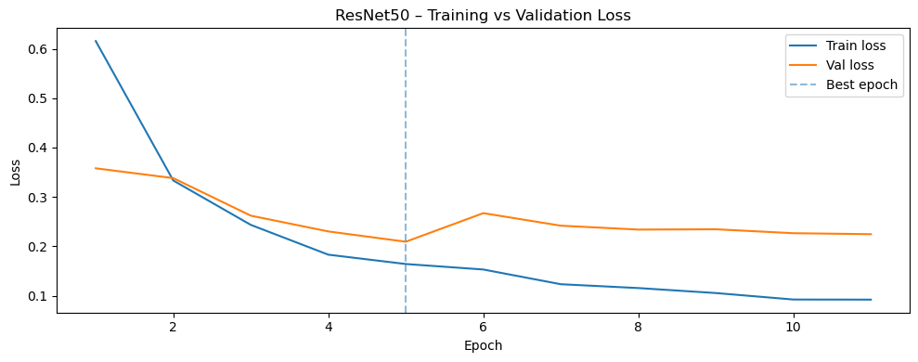
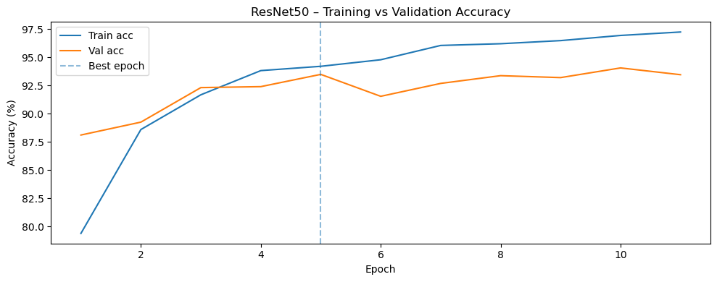
Modeling Approach (Training Strategy)
Optimizer: Adam (learning rate α = 1e-4)
Loss Function: CrossEntropyLoss (log loss)
Training Setup:
Full fine-tuning (all layers updated)
60/20/20 stratified split.
Epochs:
Max 30 epochs
Early stopping (patience = 5)
Best model selected based on validation loss
Why early stopping?:
Prevents overfitting
Reduces training time
Observed behavior:
Stable convergence
Train accuracy rose from ~79% → ~ 97%
Validation accuracy peaked at ~94%
Robustness check with a different random-seeded split.
Notes:
Invasive weeds create major ecological, agricultural, and economic damage worldwide.
For example, Lantana camara is recognized by the IUCN as one of the world’s worst invasive species. It forms dense thickets, displaces native vegetation, and is toxic to livestock. Similarly, Parthenium hysterophorus is classified globally as a highly noxious weed, causing skin allergies, respiratory issues, livestock poisoning, and agricultural losses across India, Australia, and the Americas.
The DeepWeeds dataset provides a challenging, real-world benchmark because these species are visually similar, appear in natural clutter, and can vary widely in lighting and growth stages.
But this problem is not limited to large rangelands.
Even in the U.S., homeowners spend billions annually on weed control. Many invasive weeds compete with grass for water, degrade soil quality, and increase irrigation and maintenance costs. Today, most control is either manual or relies on broad chemical spraying.
A reliable AI-based weed identification system could make weed management:
– more water-efficient,
– less chemical-intensive, and
– more affordable for everyday environments.
Beyond classification, interpretability is crucial.
Whether these models are used in robotics, drones, lawn-care automation, or environmental monitoring, we need to know why the model made a decision, not just what it predicted.
That is why this project focuses not only on reproducing accurate classification but also on interpretable classification via Grad-CAM, which gives insight into what parts of the plant the model actually uses to make decisions.
How this fits into remote sensing course?
“Although this project uses ground-level RGB images, the same ideas — species identification, spatial reasoning, interpretability, and model generalization — directly extend to remote sensing tasks such as crop monitoring, invasive species mapping, forestry analysis, and even disaster assessment. Weed detection is simply a controlled, grounded case study that lets me practice the exact skills used in satellite, UAV, and hyperspectral pipelines.” Preprocessing: For the training set, I used lightweight augmentations — random resized crop, horizontal flip, and mild color jitter — to help the model generalize to cluttered field conditions. The validation and test sets only used resizing and normalization so that the evaluation remains clean.
Modeling Approach:
Why transfer learning? Because most of the network’s filters are already pretrained on millions of images, the model starts with general, robust visual features rather than learning everything from a small weed dataset. This means fewer parameters need to be “learned from scratch,” lowering the risk of overfitting.
Adam optimizer: Adam optimizer combines the momentum(mean estimate) and RMSprop techniques(variance estimate) to provide a more balanced and efficient optimization process.

Slide 11
Modeling Approach (Training Strategy by DeepWeeds) Reference only
CNN: Resnet-50 from scratch
Pretrained weights: NO
Epochs: 100
Early stopping: NO
Optimizer: Stochastic Gradient Descent (SGD) with momentum (not Adam)
Learning rate schedule: manually decayed over time.
Batch size: 32 (same)
Augmentations:
Resize 256 → 224
Horizontal flip
Light brightness jitter
Split: 8 geographical sites
7 sites for training
1 held-out site for validation
Rotated in a leave-one-site-out (LOSO) approach
Hardware: NVIDIA P100 GPU cluster (much more compute)
DeepWeeds used a resource-heavy training setup: 100 epoch scratch training with no transfer learning and a geographically stratified evaluation. For this course, a practical and modern transfer-learning pipeline was implemented. Using ImageNet weights and early stopping, similar accuracy was achieved in only 11 epochs and with dramatically less computation.
Notes:
Invasive weeds create major ecological, agricultural, and economic damage worldwide.
For example, Lantana camara is recognized by the IUCN as one of the world’s worst invasive species. It forms dense thickets, displaces native vegetation, and is toxic to livestock. Similarly, Parthenium hysterophorus is classified globally as a highly noxious weed, causing skin allergies, respiratory issues, livestock poisoning, and agricultural losses across India, Australia, and the Americas.
The DeepWeeds dataset provides a challenging, real-world benchmark because these species are visually similar, appear in natural clutter, and can vary widely in lighting and growth stages.
But this problem is not limited to large rangelands.
Even in the U.S., homeowners spend billions annually on weed control. Many invasive weeds compete with grass for water, degrade soil quality, and increase irrigation and maintenance costs. Today, most control is either manual or relies on broad chemical spraying.
A reliable AI-based weed identification system could make weed management:
– more water-efficient,
– less chemical-intensive, and
– more affordable for everyday environments.
Beyond classification, interpretability is crucial.
Whether these models are used in robotics, drones, lawn-care automation, or environmental monitoring, we need to know why the model made a decision, not just what it predicted.
That is why this project focuses not only on reproducing accurate classification but also on interpretable classification via Grad-CAM, which gives insight into what parts of the plant the model actually uses to make decisions.
How this fits into remote sensing course?
“Although this project uses ground-level RGB images, the same ideas — species identification, spatial reasoning, interpretability, and model generalization — directly extend to remote sensing tasks such as crop monitoring, invasive species mapping, forestry analysis, and even disaster assessment. Weed detection is simply a controlled, grounded case study that lets me practice the exact skills used in satellite, UAV, and hyperspectral pipelines.” Preprocessing: For the training set, I used lightweight augmentations — random resized crop, horizontal flip, and mild color jitter — to help the model generalize to cluttered field conditions. The validation and test sets only used resizing and normalization so that the evaluation remains clean.
Modeling Approach:
Why transfer learning? Because most of the network’s filters are already pretrained on millions of images, the model starts with general, robust visual features rather than learning everything from a small weed dataset. This means fewer parameters need to be “learned from scratch,” lowering the risk of overfitting.
Adam optimizer: Adam optimizer combines the momentum(mean estimate) and RMSprop techniques(variance estimate) to provide a more balanced and efficient optimization process.

Slide 12
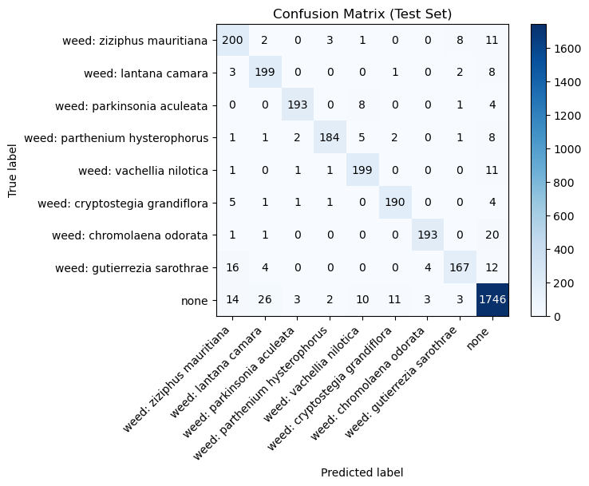
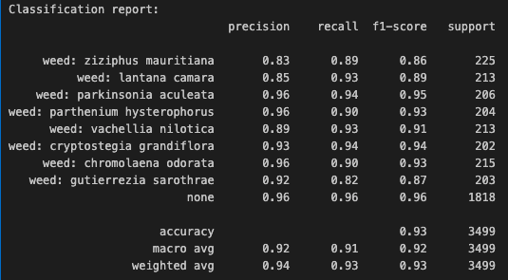
Results – Accuracy & Evaluation
Test Accuracy: 93.48% | 95.7% deepweeds
Repeated split accuracy: 93.60%
Macro F1-score: ~0.92
Weighted F1-score: ~0.93
Performance consistent across two random splits (robustness check)
Most misclassifications stem from visually similar species or heavy background clutter.
Notes:
Invasive weeds create major ecological, agricultural, and economic damage worldwide.
For example, Lantana camara is recognized by the IUCN as one of the world’s worst invasive species. It forms dense thickets, displaces native vegetation, and is toxic to livestock. Similarly, Parthenium hysterophorus is classified globally as a highly noxious weed, causing skin allergies, respiratory issues, livestock poisoning, and agricultural losses across India, Australia, and the Americas.
The DeepWeeds dataset provides a challenging, real-world benchmark because these species are visually similar, appear in natural clutter, and can vary widely in lighting and growth stages.
But this problem is not limited to large rangelands.
Even in the U.S., homeowners spend billions annually on weed control. Many invasive weeds compete with grass for water, degrade soil quality, and increase irrigation and maintenance costs. Today, most control is either manual or relies on broad chemical spraying.
A reliable AI-based weed identification system could make weed management:
– more water-efficient,
– less chemical-intensive, and
– more affordable for everyday environments.
Beyond classification, interpretability is crucial.
Whether these models are used in robotics, drones, lawn-care automation, or environmental monitoring, we need to know why the model made a decision, not just what it predicted.
That is why this project focuses not only on reproducing accurate classification but also on interpretable classification via Grad-CAM, which gives insight into what parts of the plant the model actually uses to make decisions.
How this fits into remote sensing course?
“Although this project uses ground-level RGB images, the same ideas — species identification, spatial reasoning, interpretability, and model generalization — directly extend to remote sensing tasks such as crop monitoring, invasive species mapping, forestry analysis, and even disaster assessment. Weed detection is simply a controlled, grounded case study that lets me practice the exact skills used in satellite, UAV, and hyperspectral pipelines.” Preprocessing: For the training set, I used lightweight augmentations — random resized crop, horizontal flip, and mild color jitter — to help the model generalize to cluttered field conditions. The validation and test sets only used resizing and normalization so that the evaluation remains clean.
Modeling Approach:
Why transfer learning? Because most of the network’s filters are already pretrained on millions of images, the model starts with general, robust visual features rather than learning everything from a small weed dataset. This means fewer parameters need to be “learned from scratch,” lowering the risk of overfitting.
Adam optimizer: Adam optimizer combines the momentum(mean estimate) and RMSprop techniques(variance estimate) to provide a more balanced and efficient optimization process.

Slide 13
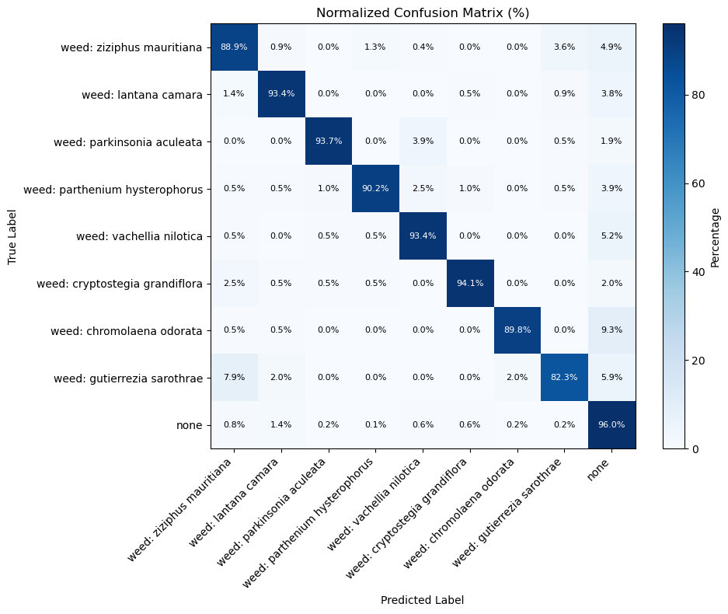
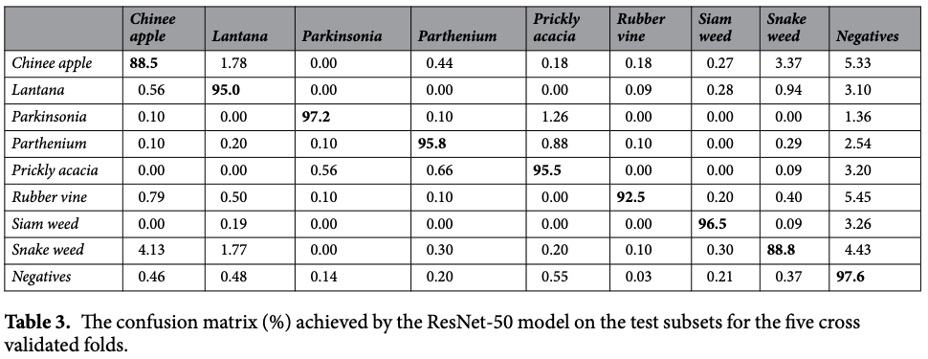
Results – Confusion Matrix Comparison Reference only
Notes:
Invasive weeds create major ecological, agricultural, and economic damage worldwide.
For example, Lantana camara is recognized by the IUCN as one of the world’s worst invasive species. It forms dense thickets, displaces native vegetation, and is toxic to livestock. Similarly, Parthenium hysterophorus is classified globally as a highly noxious weed, causing skin allergies, respiratory issues, livestock poisoning, and agricultural losses across India, Australia, and the Americas.
The DeepWeeds dataset provides a challenging, real-world benchmark because these species are visually similar, appear in natural clutter, and can vary widely in lighting and growth stages.
But this problem is not limited to large rangelands.
Even in the U.S., homeowners spend billions annually on weed control. Many invasive weeds compete with grass for water, degrade soil quality, and increase irrigation and maintenance costs. Today, most control is either manual or relies on broad chemical spraying.
A reliable AI-based weed identification system could make weed management:
– more water-efficient,
– less chemical-intensive, and
– more affordable for everyday environments.
Beyond classification, interpretability is crucial.
Whether these models are used in robotics, drones, lawn-care automation, or environmental monitoring, we need to know why the model made a decision, not just what it predicted.
That is why this project focuses not only on reproducing accurate classification but also on interpretable classification via Grad-CAM, which gives insight into what parts of the plant the model actually uses to make decisions.
How this fits into remote sensing course?
“Although this project uses ground-level RGB images, the same ideas — species identification, spatial reasoning, interpretability, and model generalization — directly extend to remote sensing tasks such as crop monitoring, invasive species mapping, forestry analysis, and even disaster assessment. Weed detection is simply a controlled, grounded case study that lets me practice the exact skills used in satellite, UAV, and hyperspectral pipelines.” Preprocessing: For the training set, I used lightweight augmentations — random resized crop, horizontal flip, and mild color jitter — to help the model generalize to cluttered field conditions. The validation and test sets only used resizing and normalization so that the evaluation remains clean.
Modeling Approach:
Why transfer learning? Because most of the network’s filters are already pretrained on millions of images, the model starts with general, robust visual features rather than learning everything from a small weed dataset. This means fewer parameters need to be “learned from scratch,” lowering the risk of overfitting.
Adam optimizer: Adam optimizer combines the momentum(mean estimate) and RMSprop techniques(variance estimate) to provide a more balanced and efficient optimization process.

Slide 14
Results – Class-wise performance | Misclassification pattern
Most mistakes happen between “weed” and “none”, especially when the weed is small, occluded, or blends into background vegetation.
Fine-grained confusions occur between visually similar species, which is expected in cluttered natural scenes.
Distinctive species show very few errors, meaning the model relies heavily on clear morphological cues.
Overall error patterns are intuitive and match the limitations of real-world field imagery (lighting, clutter, partial visibility).
Notes:
Invasive weeds create major ecological, agricultural, and economic damage worldwide.
For example, Lantana camara is recognized by the IUCN as one of the world’s worst invasive species. It forms dense thickets, displaces native vegetation, and is toxic to livestock. Similarly, Parthenium hysterophorus is classified globally as a highly noxious weed, causing skin allergies, respiratory issues, livestock poisoning, and agricultural losses across India, Australia, and the Americas.
The DeepWeeds dataset provides a challenging, real-world benchmark because these species are visually similar, appear in natural clutter, and can vary widely in lighting and growth stages.
But this problem is not limited to large rangelands.
Even in the U.S., homeowners spend billions annually on weed control. Many invasive weeds compete with grass for water, degrade soil quality, and increase irrigation and maintenance costs. Today, most control is either manual or relies on broad chemical spraying.
A reliable AI-based weed identification system could make weed management:
– more water-efficient,
– less chemical-intensive, and
– more affordable for everyday environments.
Beyond classification, interpretability is crucial.
Whether these models are used in robotics, drones, lawn-care automation, or environmental monitoring, we need to know why the model made a decision, not just what it predicted.
That is why this project focuses not only on reproducing accurate classification but also on interpretable classification via Grad-CAM, which gives insight into what parts of the plant the model actually uses to make decisions.
How this fits into remote sensing course?
“Although this project uses ground-level RGB images, the same ideas — species identification, spatial reasoning, interpretability, and model generalization — directly extend to remote sensing tasks such as crop monitoring, invasive species mapping, forestry analysis, and even disaster assessment. Weed detection is simply a controlled, grounded case study that lets me practice the exact skills used in satellite, UAV, and hyperspectral pipelines.” Preprocessing: For the training set, I used lightweight augmentations — random resized crop, horizontal flip, and mild color jitter — to help the model generalize to cluttered field conditions. The validation and test sets only used resizing and normalization so that the evaluation remains clean.
Modeling Approach:
Why transfer learning? Because most of the network’s filters are already pretrained on millions of images, the model starts with general, robust visual features rather than learning everything from a small weed dataset. This means fewer parameters need to be “learned from scratch,” lowering the risk of overfitting.
Adam optimizer: Adam optimizer combines the momentum(mean estimate) and RMSprop techniques(variance estimate) to provide a more balanced and efficient optimization process.

Slide 15
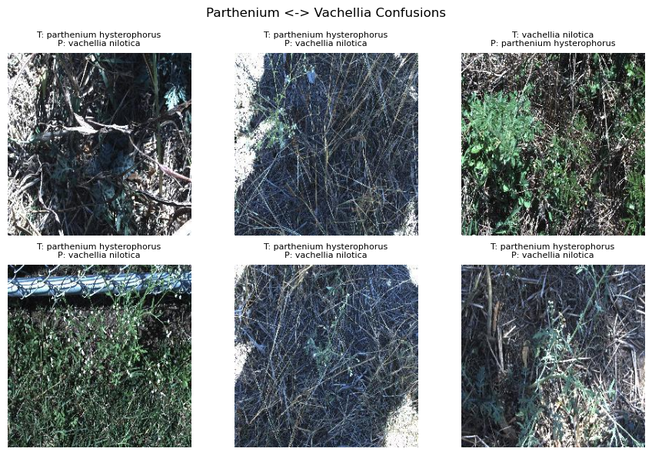
Results – Class-wise performance | Misclassification pattern
Reference only
Confusion between similar looking weeds:
Notes:
Invasive weeds create major ecological, agricultural, and economic damage worldwide.
For example, Lantana camara is recognized by the IUCN as one of the world’s worst invasive species. It forms dense thickets, displaces native vegetation, and is toxic to livestock. Similarly, Parthenium hysterophorus is classified globally as a highly noxious weed, causing skin allergies, respiratory issues, livestock poisoning, and agricultural losses across India, Australia, and the Americas.
The DeepWeeds dataset provides a challenging, real-world benchmark because these species are visually similar, appear in natural clutter, and can vary widely in lighting and growth stages.
But this problem is not limited to large rangelands.
Even in the U.S., homeowners spend billions annually on weed control. Many invasive weeds compete with grass for water, degrade soil quality, and increase irrigation and maintenance costs. Today, most control is either manual or relies on broad chemical spraying.
A reliable AI-based weed identification system could make weed management:
– more water-efficient,
– less chemical-intensive, and
– more affordable for everyday environments.
Beyond classification, interpretability is crucial.
Whether these models are used in robotics, drones, lawn-care automation, or environmental monitoring, we need to know why the model made a decision, not just what it predicted.
That is why this project focuses not only on reproducing accurate classification but also on interpretable classification via Grad-CAM, which gives insight into what parts of the plant the model actually uses to make decisions.
How this fits into remote sensing course?
“Although this project uses ground-level RGB images, the same ideas — species identification, spatial reasoning, interpretability, and model generalization — directly extend to remote sensing tasks such as crop monitoring, invasive species mapping, forestry analysis, and even disaster assessment. Weed detection is simply a controlled, grounded case study that lets me practice the exact skills used in satellite, UAV, and hyperspectral pipelines.” Preprocessing: For the training set, I used lightweight augmentations — random resized crop, horizontal flip, and mild color jitter — to help the model generalize to cluttered field conditions. The validation and test sets only used resizing and normalization so that the evaluation remains clean.
Modeling Approach:
Why transfer learning? Because most of the network’s filters are already pretrained on millions of images, the model starts with general, robust visual features rather than learning everything from a small weed dataset. This means fewer parameters need to be “learned from scratch,” lowering the risk of overfitting.
Adam optimizer: Adam optimizer combines the momentum(mean estimate) and RMSprop techniques(variance estimate) to provide a more balanced and efficient optimization process.

Slide 16
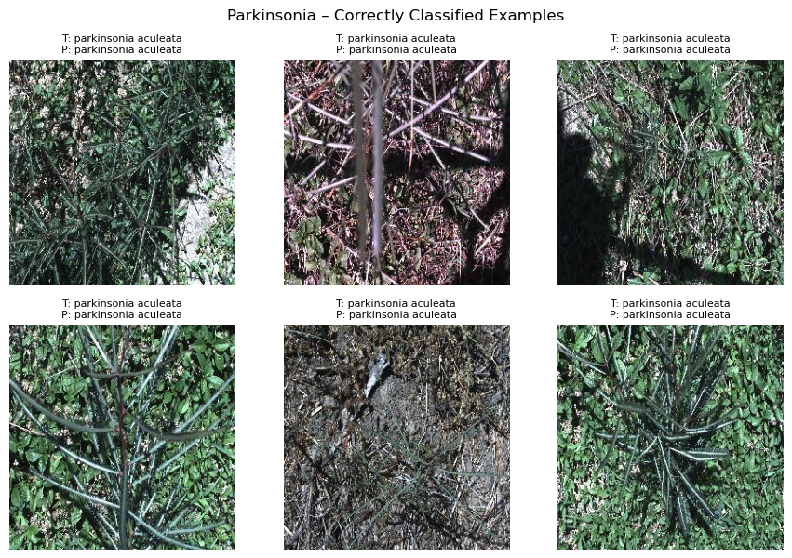
Results – Class-wise performance | Misclassification pattern
Reference only
Distinctive species – Correct Classification
Notes:
Invasive weeds create major ecological, agricultural, and economic damage worldwide.
For example, Lantana camara is recognized by the IUCN as one of the world’s worst invasive species. It forms dense thickets, displaces native vegetation, and is toxic to livestock. Similarly, Parthenium hysterophorus is classified globally as a highly noxious weed, causing skin allergies, respiratory issues, livestock poisoning, and agricultural losses across India, Australia, and the Americas.
The DeepWeeds dataset provides a challenging, real-world benchmark because these species are visually similar, appear in natural clutter, and can vary widely in lighting and growth stages.
But this problem is not limited to large rangelands.
Even in the U.S., homeowners spend billions annually on weed control. Many invasive weeds compete with grass for water, degrade soil quality, and increase irrigation and maintenance costs. Today, most control is either manual or relies on broad chemical spraying.
A reliable AI-based weed identification system could make weed management:
– more water-efficient,
– less chemical-intensive, and
– more affordable for everyday environments.
Beyond classification, interpretability is crucial.
Whether these models are used in robotics, drones, lawn-care automation, or environmental monitoring, we need to know why the model made a decision, not just what it predicted.
That is why this project focuses not only on reproducing accurate classification but also on interpretable classification via Grad-CAM, which gives insight into what parts of the plant the model actually uses to make decisions.
How this fits into remote sensing course?
“Although this project uses ground-level RGB images, the same ideas — species identification, spatial reasoning, interpretability, and model generalization — directly extend to remote sensing tasks such as crop monitoring, invasive species mapping, forestry analysis, and even disaster assessment. Weed detection is simply a controlled, grounded case study that lets me practice the exact skills used in satellite, UAV, and hyperspectral pipelines.” Preprocessing: For the training set, I used lightweight augmentations — random resized crop, horizontal flip, and mild color jitter — to help the model generalize to cluttered field conditions. The validation and test sets only used resizing and normalization so that the evaluation remains clean.
Modeling Approach:
Why transfer learning? Because most of the network’s filters are already pretrained on millions of images, the model starts with general, robust visual features rather than learning everything from a small weed dataset. This means fewer parameters need to be “learned from scratch,” lowering the risk of overfitting.
Adam optimizer: Adam optimizer combines the momentum(mean estimate) and RMSprop techniques(variance estimate) to provide a more balanced and efficient optimization process.

Slide 17
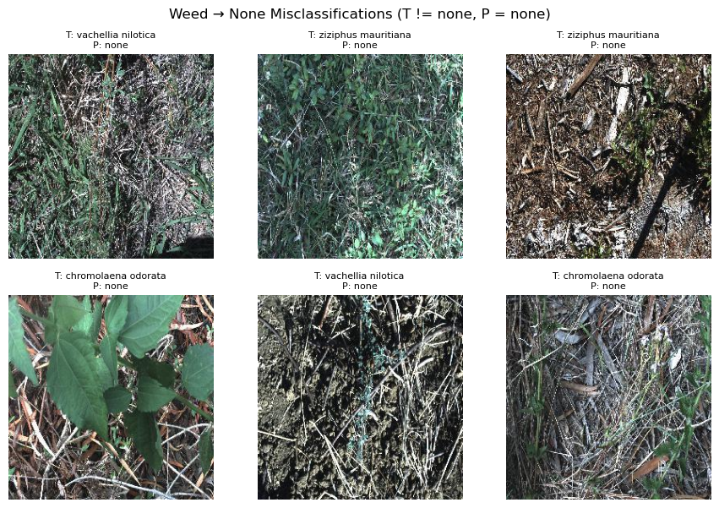
Results – Class-wise performance | Misclassification pattern
Reference only
Misclassification of Weed → None class
Notes:
Invasive weeds create major ecological, agricultural, and economic damage worldwide.
For example, Lantana camara is recognized by the IUCN as one of the world’s worst invasive species. It forms dense thickets, displaces native vegetation, and is toxic to livestock. Similarly, Parthenium hysterophorus is classified globally as a highly noxious weed, causing skin allergies, respiratory issues, livestock poisoning, and agricultural losses across India, Australia, and the Americas.
The DeepWeeds dataset provides a challenging, real-world benchmark because these species are visually similar, appear in natural clutter, and can vary widely in lighting and growth stages.
But this problem is not limited to large rangelands.
Even in the U.S., homeowners spend billions annually on weed control. Many invasive weeds compete with grass for water, degrade soil quality, and increase irrigation and maintenance costs. Today, most control is either manual or relies on broad chemical spraying.
A reliable AI-based weed identification system could make weed management:
– more water-efficient,
– less chemical-intensive, and
– more affordable for everyday environments.
Beyond classification, interpretability is crucial.
Whether these models are used in robotics, drones, lawn-care automation, or environmental monitoring, we need to know why the model made a decision, not just what it predicted.
That is why this project focuses not only on reproducing accurate classification but also on interpretable classification via Grad-CAM, which gives insight into what parts of the plant the model actually uses to make decisions.
How this fits into remote sensing course?
“Although this project uses ground-level RGB images, the same ideas — species identification, spatial reasoning, interpretability, and model generalization — directly extend to remote sensing tasks such as crop monitoring, invasive species mapping, forestry analysis, and even disaster assessment. Weed detection is simply a controlled, grounded case study that lets me practice the exact skills used in satellite, UAV, and hyperspectral pipelines.” Preprocessing: For the training set, I used lightweight augmentations — random resized crop, horizontal flip, and mild color jitter — to help the model generalize to cluttered field conditions. The validation and test sets only used resizing and normalization so that the evaluation remains clean.
Modeling Approach:
Why transfer learning? Because most of the network’s filters are already pretrained on millions of images, the model starts with general, robust visual features rather than learning everything from a small weed dataset. This means fewer parameters need to be “learned from scratch,” lowering the risk of overfitting.
Adam optimizer: Adam optimizer combines the momentum(mean estimate) and RMSprop techniques(variance estimate) to provide a more balanced and efficient optimization process.

Slide 18
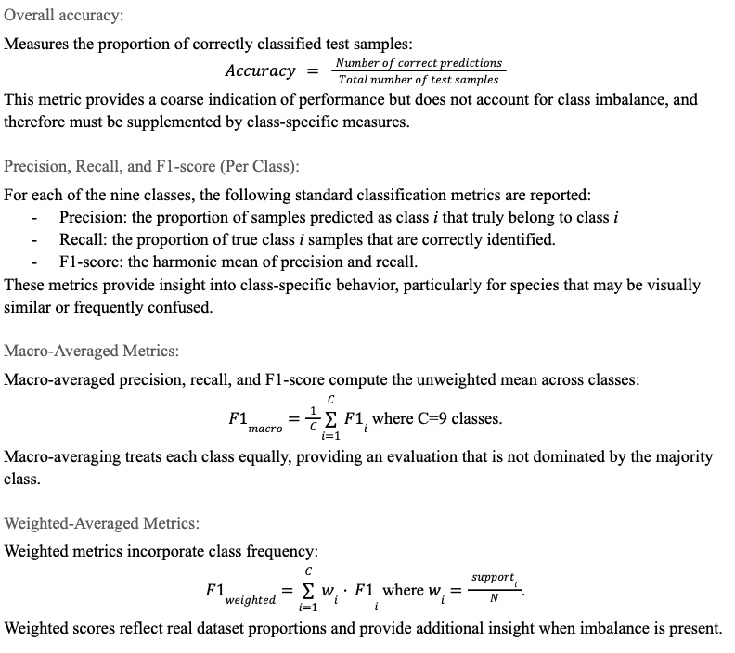
Results – Accuracy & Evaluation Metric definitions Reference only
Notes:
Invasive weeds create major ecological, agricultural, and economic damage worldwide.
For example, Lantana camara is recognized by the IUCN as one of the world’s worst invasive species. It forms dense thickets, displaces native vegetation, and is toxic to livestock. Similarly, Parthenium hysterophorus is classified globally as a highly noxious weed, causing skin allergies, respiratory issues, livestock poisoning, and agricultural losses across India, Australia, and the Americas.
The DeepWeeds dataset provides a challenging, real-world benchmark because these species are visually similar, appear in natural clutter, and can vary widely in lighting and growth stages.
But this problem is not limited to large rangelands.
Even in the U.S., homeowners spend billions annually on weed control. Many invasive weeds compete with grass for water, degrade soil quality, and increase irrigation and maintenance costs. Today, most control is either manual or relies on broad chemical spraying.
A reliable AI-based weed identification system could make weed management:
– more water-efficient,
– less chemical-intensive, and
– more affordable for everyday environments.
Beyond classification, interpretability is crucial.
Whether these models are used in robotics, drones, lawn-care automation, or environmental monitoring, we need to know why the model made a decision, not just what it predicted.
That is why this project focuses not only on reproducing accurate classification but also on interpretable classification via Grad-CAM, which gives insight into what parts of the plant the model actually uses to make decisions.
How this fits into remote sensing course?
“Although this project uses ground-level RGB images, the same ideas — species identification, spatial reasoning, interpretability, and model generalization — directly extend to remote sensing tasks such as crop monitoring, invasive species mapping, forestry analysis, and even disaster assessment. Weed detection is simply a controlled, grounded case study that lets me practice the exact skills used in satellite, UAV, and hyperspectral pipelines.” Preprocessing: For the training set, I used lightweight augmentations — random resized crop, horizontal flip, and mild color jitter — to help the model generalize to cluttered field conditions. The validation and test sets only used resizing and normalization so that the evaluation remains clean.
Modeling Approach:
Why transfer learning? Because most of the network’s filters are already pretrained on millions of images, the model starts with general, robust visual features rather than learning everything from a small weed dataset. This means fewer parameters need to be “learned from scratch,” lowering the risk of overfitting.
Adam optimizer: Adam optimizer combines the momentum(mean estimate) and RMSprop techniques(variance estimate) to provide a more balanced and efficient optimization process.

Slide 19
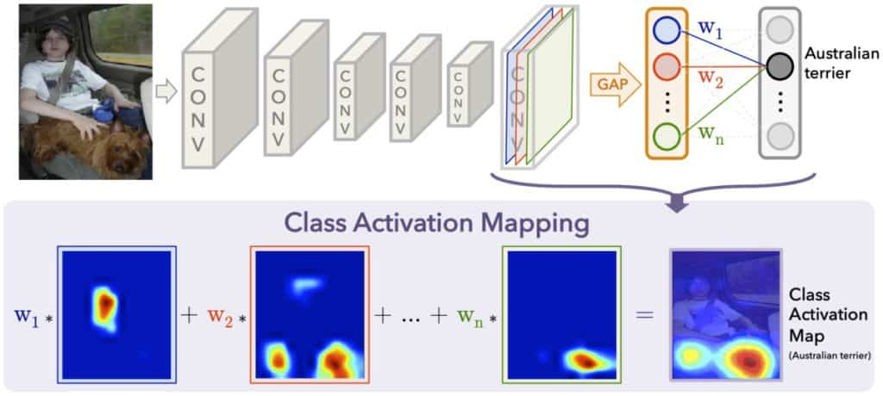
Grad-CAM Interpretability
Gradient-weighted Class Activation Map (Grad-CAM)
Visual explanation of where the CNN focuses during prediction.
Uses gradients from the final conv layer
Helps verify if the model attends to leaf structure or irrelevant background
Essential for biological/ecological trust and debugging misclassifications.
Grad-CAM creates a heatmap by combining feature activations with their importance for the predicted class, showing which image regions most influenced the model’s decision.
Notes:
Invasive weeds create major ecological, agricultural, and economic damage worldwide.
For example, Lantana camara is recognized by the IUCN as one of the world’s worst invasive species. It forms dense thickets, displaces native vegetation, and is toxic to livestock. Similarly, Parthenium hysterophorus is classified globally as a highly noxious weed, causing skin allergies, respiratory issues, livestock poisoning, and agricultural losses across India, Australia, and the Americas.
The DeepWeeds dataset provides a challenging, real-world benchmark because these species are visually similar, appear in natural clutter, and can vary widely in lighting and growth stages.
But this problem is not limited to large rangelands.
Even in the U.S., homeowners spend billions annually on weed control. Many invasive weeds compete with grass for water, degrade soil quality, and increase irrigation and maintenance costs. Today, most control is either manual or relies on broad chemical spraying.
A reliable AI-based weed identification system could make weed management:
– more water-efficient,
– less chemical-intensive, and
– more affordable for everyday environments.
Beyond classification, interpretability is crucial.
Whether these models are used in robotics, drones, lawn-care automation, or environmental monitoring, we need to know why the model made a decision, not just what it predicted.
That is why this project focuses not only on reproducing accurate classification but also on interpretable classification via Grad-CAM, which gives insight into what parts of the plant the model actually uses to make decisions.
How this fits into remote sensing course?
“Although this project uses ground-level RGB images, the same ideas — species identification, spatial reasoning, interpretability, and model generalization — directly extend to remote sensing tasks such as crop monitoring, invasive species mapping, forestry analysis, and even disaster assessment. Weed detection is simply a controlled, grounded case study that lets me practice the exact skills used in satellite, UAV, and hyperspectral pipelines.” Preprocessing: For the training set, I used lightweight augmentations — random resized crop, horizontal flip, and mild color jitter — to help the model generalize to cluttered field conditions. The validation and test sets only used resizing and normalization so that the evaluation remains clean.
Modeling Approach:
Why transfer learning? Because most of the network’s filters are already pretrained on millions of images, the model starts with general, robust visual features rather than learning everything from a small weed dataset. This means fewer parameters need to be “learned from scratch,” lowering the risk of overfitting.
Adam optimizer: Adam optimizer combines the momentum(mean estimate) and RMSprop techniques(variance estimate) to provide a more balanced and efficient optimization process. Grad-CAM:
Grad-CAM gives us a heatmap showing the spatial regions the model relies on when predicting a class. In the context of weeds, this allows us to check whether the classifier is actually looking at the plant itself — the leaf clusters, branching structure, or texture — or whether it gets distracted by background vegetation. This is important both for scientific interpretability and for downstream robotic or ecological uses

Slide 20
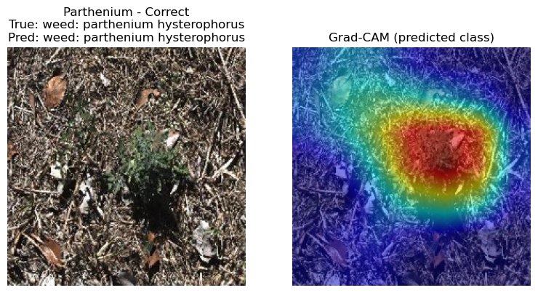
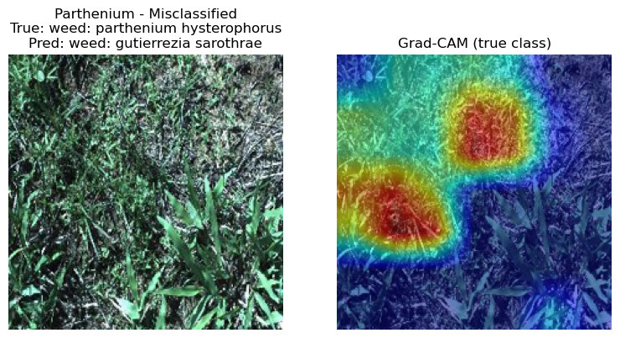
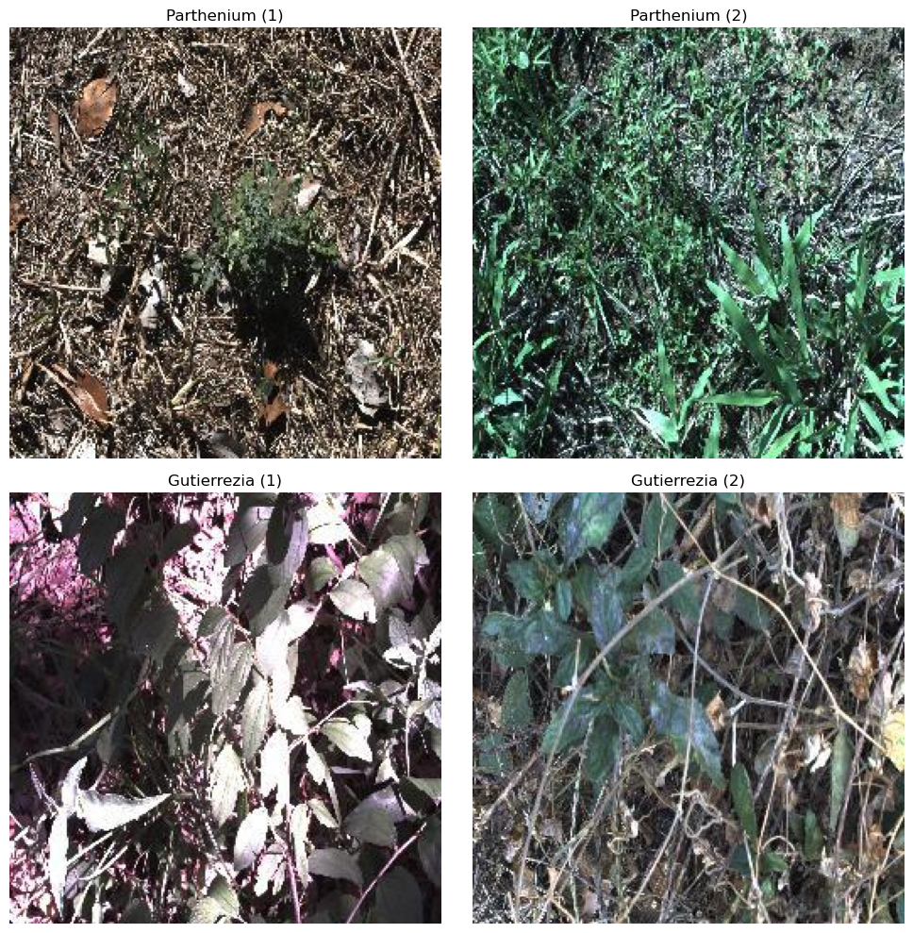
Grad-CAM Interpretability
Notes:
Invasive weeds create major ecological, agricultural, and economic damage worldwide.
For example, Lantana camara is recognized by the IUCN as one of the world’s worst invasive species. It forms dense thickets, displaces native vegetation, and is toxic to livestock. Similarly, Parthenium hysterophorus is classified globally as a highly noxious weed, causing skin allergies, respiratory issues, livestock poisoning, and agricultural losses across India, Australia, and the Americas.
The DeepWeeds dataset provides a challenging, real-world benchmark because these species are visually similar, appear in natural clutter, and can vary widely in lighting and growth stages.
But this problem is not limited to large rangelands.
Even in the U.S., homeowners spend billions annually on weed control. Many invasive weeds compete with grass for water, degrade soil quality, and increase irrigation and maintenance costs. Today, most control is either manual or relies on broad chemical spraying.
A reliable AI-based weed identification system could make weed management:
– more water-efficient,
– less chemical-intensive, and
– more affordable for everyday environments.
Beyond classification, interpretability is crucial.
Whether these models are used in robotics, drones, lawn-care automation, or environmental monitoring, we need to know why the model made a decision, not just what it predicted.
That is why this project focuses not only on reproducing accurate classification but also on interpretable classification via Grad-CAM, which gives insight into what parts of the plant the model actually uses to make decisions.
How this fits into remote sensing course?
“Although this project uses ground-level RGB images, the same ideas — species identification, spatial reasoning, interpretability, and model generalization — directly extend to remote sensing tasks such as crop monitoring, invasive species mapping, forestry analysis, and even disaster assessment. Weed detection is simply a controlled, grounded case study that lets me practice the exact skills used in satellite, UAV, and hyperspectral pipelines.” Preprocessing: For the training set, I used lightweight augmentations — random resized crop, horizontal flip, and mild color jitter — to help the model generalize to cluttered field conditions. The validation and test sets only used resizing and normalization so that the evaluation remains clean.
Modeling Approach:
Why transfer learning? Because most of the network’s filters are already pretrained on millions of images, the model starts with general, robust visual features rather than learning everything from a small weed dataset. This means fewer parameters need to be “learned from scratch,” lowering the risk of overfitting.
Adam optimizer: Adam optimizer combines the momentum(mean estimate) and RMSprop techniques(variance estimate) to provide a more balanced and efficient optimization process. Grad-CAM:
Grad-CAM gives us a heatmap showing the spatial regions the model relies on when predicting a class. In the context of weeds, this allows us to check whether the classifier is actually looking at the plant itself — the leaf clusters, branching structure, or texture — or whether it gets distracted by background vegetation. This is important both for scientific interpretability and for downstream robotic or ecological uses
Grad-CAM uses the model’s gradients to show what parts of the image it relied on when making a prediction.

Slide 21
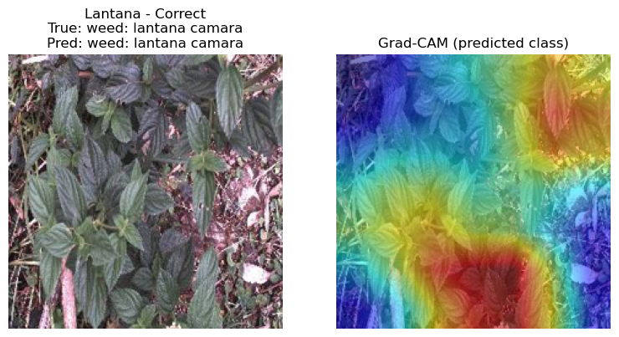
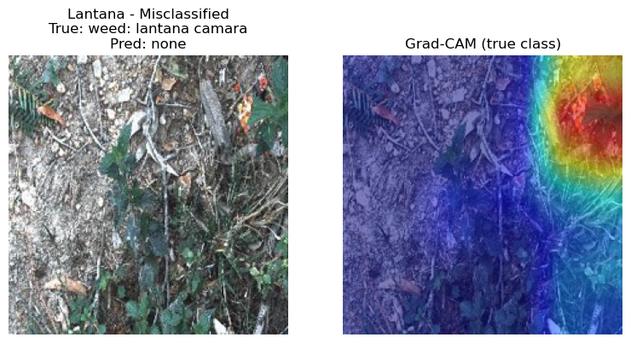
Grad-CAM Interpretability
Notes:
Invasive weeds create major ecological, agricultural, and economic damage worldwide.
For example, Lantana camara is recognized by the IUCN as one of the world’s worst invasive species. It forms dense thickets, displaces native vegetation, and is toxic to livestock. Similarly, Parthenium hysterophorus is classified globally as a highly noxious weed, causing skin allergies, respiratory issues, livestock poisoning, and agricultural losses across India, Australia, and the Americas.
The DeepWeeds dataset provides a challenging, real-world benchmark because these species are visually similar, appear in natural clutter, and can vary widely in lighting and growth stages.
But this problem is not limited to large rangelands.
Even in the U.S., homeowners spend billions annually on weed control. Many invasive weeds compete with grass for water, degrade soil quality, and increase irrigation and maintenance costs. Today, most control is either manual or relies on broad chemical spraying.
A reliable AI-based weed identification system could make weed management:
– more water-efficient,
– less chemical-intensive, and
– more affordable for everyday environments.
Beyond classification, interpretability is crucial.
Whether these models are used in robotics, drones, lawn-care automation, or environmental monitoring, we need to know why the model made a decision, not just what it predicted.
That is why this project focuses not only on reproducing accurate classification but also on interpretable classification via Grad-CAM, which gives insight into what parts of the plant the model actually uses to make decisions.
How this fits into remote sensing course?
“Although this project uses ground-level RGB images, the same ideas — species identification, spatial reasoning, interpretability, and model generalization — directly extend to remote sensing tasks such as crop monitoring, invasive species mapping, forestry analysis, and even disaster assessment. Weed detection is simply a controlled, grounded case study that lets me practice the exact skills used in satellite, UAV, and hyperspectral pipelines.” Preprocessing: For the training set, I used lightweight augmentations — random resized crop, horizontal flip, and mild color jitter — to help the model generalize to cluttered field conditions. The validation and test sets only used resizing and normalization so that the evaluation remains clean.
Modeling Approach:
Why transfer learning? Because most of the network’s filters are already pretrained on millions of images, the model starts with general, robust visual features rather than learning everything from a small weed dataset. This means fewer parameters need to be “learned from scratch,” lowering the risk of overfitting.
Adam optimizer: Adam optimizer combines the momentum(mean estimate) and RMSprop techniques(variance estimate) to provide a more balanced and efficient optimization process. Grad-CAM:
Grad-CAM gives us a heatmap showing the spatial regions the model relies on when predicting a class. In the context of weeds, this allows us to check whether the classifier is actually looking at the plant itself — the leaf clusters, branching structure, or texture — or whether it gets distracted by background vegetation. This is important both for scientific interpretability and for downstream robotic or ecological uses
Grad-CAM uses the model’s gradients to show what parts of the image it relied on when making a prediction.

Slide 22
Discussions
The ResNet-50 model achieved strong and stable performance (~93–94%), consistent with DeepWeeds’ original findings.
Grad-CAM showed that the network generally focuses on leaf structure, texture, and branch clusters, confirming meaningful feature learning.
Misclassifications mostly happened under cluttered vegetation, poor lighting, or between visually similar species.
Notes:
Invasive weeds create major ecological, agricultural, and economic damage worldwide.
For example, Lantana camara is recognized by the IUCN as one of the world’s worst invasive species. It forms dense thickets, displaces native vegetation, and is toxic to livestock. Similarly, Parthenium hysterophorus is classified globally as a highly noxious weed, causing skin allergies, respiratory issues, livestock poisoning, and agricultural losses across India, Australia, and the Americas.
The DeepWeeds dataset provides a challenging, real-world benchmark because these species are visually similar, appear in natural clutter, and can vary widely in lighting and growth stages.
But this problem is not limited to large rangelands.
Even in the U.S., homeowners spend billions annually on weed control. Many invasive weeds compete with grass for water, degrade soil quality, and increase irrigation and maintenance costs. Today, most control is either manual or relies on broad chemical spraying.
A reliable AI-based weed identification system could make weed management:
– more water-efficient,
– less chemical-intensive, and
– more affordable for everyday environments.
Beyond classification, interpretability is crucial.
Whether these models are used in robotics, drones, lawn-care automation, or environmental monitoring, we need to know why the model made a decision, not just what it predicted.
That is why this project focuses not only on reproducing accurate classification but also on interpretable classification via Grad-CAM, which gives insight into what parts of the plant the model actually uses to make decisions.
How this fits into remote sensing course?
“Although this project uses ground-level RGB images, the same ideas — species identification, spatial reasoning, interpretability, and model generalization — directly extend to remote sensing tasks such as crop monitoring, invasive species mapping, forestry analysis, and even disaster assessment. Weed detection is simply a controlled, grounded case study that lets me practice the exact skills used in satellite, UAV, and hyperspectral pipelines.” Preprocessing: For the training set, I used lightweight augmentations — random resized crop, horizontal flip, and mild color jitter — to help the model generalize to cluttered field conditions. The validation and test sets only used resizing and normalization so that the evaluation remains clean.
Modeling Approach:
Why transfer learning? Because most of the network’s filters are already pretrained on millions of images, the model starts with general, robust visual features rather than learning everything from a small weed dataset. This means fewer parameters need to be “learned from scratch,” lowering the risk of overfitting.
Adam optimizer: Adam optimizer combines the momentum(mean estimate) and RMSprop techniques(variance estimate) to provide a more balanced and efficient optimization process. Grad-CAM:
Grad-CAM gives us a heatmap showing the spatial regions the model relies on when predicting a class. In the context of weeds, this allows us to check whether the classifier is actually looking at the plant itself — the leaf clusters, branching structure, or texture — or whether it gets distracted by background vegetation. This is important both for scientific interpretability and for downstream robotic or ecological uses

Slide 23
Limitations
RGB-only dataset
Limited spectral information → harder to distinguish species with similar color/texture.
No spatial annotations:
No bounding boxes, or segmentations masks → cannot directly evaluate crown localization.
One primary train/val/test split:
A second seed confirmed stability, but full K-fold or multi-site splits were not implemented.
Transfer learning vs. “from scratch” mismatch:
DeepWeeds trained from scratch; this project used ImageNet features → not a perfect comparison. Heuristic comparison only.
Interpretability constraints:
Grad-CAM sometimes highlighted background regions in misclassified images → attention may drift under clutter.
Lack of time ;-;
What this means:
The pipeline is strong, replicable, and interpretable,
but not yet crown-aware, not yet spatial, and not yet field-robust → perfect setup for future work.
Notes:
Invasive weeds create major ecological, agricultural, and economic damage worldwide.
For example, Lantana camara is recognized by the IUCN as one of the world’s worst invasive species. It forms dense thickets, displaces native vegetation, and is toxic to livestock. Similarly, Parthenium hysterophorus is classified globally as a highly noxious weed, causing skin allergies, respiratory issues, livestock poisoning, and agricultural losses across India, Australia, and the Americas.
The DeepWeeds dataset provides a challenging, real-world benchmark because these species are visually similar, appear in natural clutter, and can vary widely in lighting and growth stages.
But this problem is not limited to large rangelands.
Even in the U.S., homeowners spend billions annually on weed control. Many invasive weeds compete with grass for water, degrade soil quality, and increase irrigation and maintenance costs. Today, most control is either manual or relies on broad chemical spraying.
A reliable AI-based weed identification system could make weed management:
– more water-efficient,
– less chemical-intensive, and
– more affordable for everyday environments.
Beyond classification, interpretability is crucial.
Whether these models are used in robotics, drones, lawn-care automation, or environmental monitoring, we need to know why the model made a decision, not just what it predicted.
That is why this project focuses not only on reproducing accurate classification but also on interpretable classification via Grad-CAM, which gives insight into what parts of the plant the model actually uses to make decisions.
How this fits into remote sensing course?
“Although this project uses ground-level RGB images, the same ideas — species identification, spatial reasoning, interpretability, and model generalization — directly extend to remote sensing tasks such as crop monitoring, invasive species mapping, forestry analysis, and even disaster assessment. Weed detection is simply a controlled, grounded case study that lets me practice the exact skills used in satellite, UAV, and hyperspectral pipelines.” Preprocessing: For the training set, I used lightweight augmentations — random resized crop, horizontal flip, and mild color jitter — to help the model generalize to cluttered field conditions. The validation and test sets only used resizing and normalization so that the evaluation remains clean.
Modeling Approach:
Why transfer learning? Because most of the network’s filters are already pretrained on millions of images, the model starts with general, robust visual features rather than learning everything from a small weed dataset. This means fewer parameters need to be “learned from scratch,” lowering the risk of overfitting.
Adam optimizer: Adam optimizer combines the momentum(mean estimate) and RMSprop techniques(variance estimate) to provide a more balanced and efficient optimization process. Grad-CAM:
Grad-CAM gives us a heatmap showing the spatial regions the model relies on when predicting a class. In the context of weeds, this allows us to check whether the classifier is actually looking at the plant itself — the leaf clusters, branching structure, or texture — or whether it gets distracted by background vegetation. This is important both for scientific interpretability and for downstream robotic or ecological uses

Slide 24
Future Work
Crown-Center Localization:
Use Grad-CAM (or other methods) + simple masks to estimate where the weed meets the soil.
A small step towards more useful outputs for field or backyard applications.
Basic Segmentation Experiments:
Lightweight models (U-Net/SAM masks) on a small annotated subset.
Help model focus on actual weed region, not the background.
Robustness Checks:
Test how the model behaves under changes in lighting, blur, or partial occlusion.
Important for real-world images that are less “clean” than the dataset.
Edge Deployment:
Explore running the model in compressed form (FP16/ONNX/pruning).
Useful for low-power devices like Raspberry Pi or small rover/drones.
One Additional Architecture:
Compare ResNet-50 with one modern model (eg. Swin-Tiny or EfficientNet-B0).
A simple extension that adds scientific value without large compute needs.
Broader Curiosity-Driven Extensions:
These ideas are exploratory, aimed at learning segmentation and tackling harder perception problems — not only for weeds but any object-centric tasks in robotics, ecology, or remote sensing where locating the “important region” matters.
Notes:
Invasive weeds create major ecological, agricultural, and economic damage worldwide.
For example, Lantana camara is recognized by the IUCN as one of the world’s worst invasive species. It forms dense thickets, displaces native vegetation, and is toxic to livestock. Similarly, Parthenium hysterophorus is classified globally as a highly noxious weed, causing skin allergies, respiratory issues, livestock poisoning, and agricultural losses across India, Australia, and the Americas.
The DeepWeeds dataset provides a challenging, real-world benchmark because these species are visually similar, appear in natural clutter, and can vary widely in lighting and growth stages.
But this problem is not limited to large rangelands.
Even in the U.S., homeowners spend billions annually on weed control. Many invasive weeds compete with grass for water, degrade soil quality, and increase irrigation and maintenance costs. Today, most control is either manual or relies on broad chemical spraying.
A reliable AI-based weed identification system could make weed management:
– more water-efficient,
– less chemical-intensive, and
– more affordable for everyday environments.
Beyond classification, interpretability is crucial.
Whether these models are used in robotics, drones, lawn-care automation, or environmental monitoring, we need to know why the model made a decision, not just what it predicted.
That is why this project focuses not only on reproducing accurate classification but also on interpretable classification via Grad-CAM, which gives insight into what parts of the plant the model actually uses to make decisions.
How this fits into remote sensing course?
“Although this project uses ground-level RGB images, the same ideas — species identification, spatial reasoning, interpretability, and model generalization — directly extend to remote sensing tasks such as crop monitoring, invasive species mapping, forestry analysis, and even disaster assessment. Weed detection is simply a controlled, grounded case study that lets me practice the exact skills used in satellite, UAV, and hyperspectral pipelines.” Preprocessing: For the training set, I used lightweight augmentations — random resized crop, horizontal flip, and mild color jitter — to help the model generalize to cluttered field conditions. The validation and test sets only used resizing and normalization so that the evaluation remains clean.
Modeling Approach:
Why transfer learning? Because most of the network’s filters are already pretrained on millions of images, the model starts with general, robust visual features rather than learning everything from a small weed dataset. This means fewer parameters need to be “learned from scratch,” lowering the risk of overfitting.
Adam optimizer: Adam optimizer combines the momentum(mean estimate) and RMSprop techniques(variance estimate) to provide a more balanced and efficient optimization process. Grad-CAM:
Grad-CAM gives us a heatmap showing the spatial regions the model relies on when predicting a class. In the context of weeds, this allows us to check whether the classifier is actually looking at the plant itself — the leaf clusters, branching structure, or texture — or whether it gets distracted by background vegetation. This is important both for scientific interpretability and for downstream robotic or ecological uses

Slide 25
Conclusion
Project Summary:
Reproduced the DeepWeeds classification pipeline using a modern PyTorch workflow.
Fine-tuned ResNet-50 with ImageNet weights → achieved a strong performance (~93% accuracy).
Built a clean Weed-AI → DataFrame → DataLoader pipeline.
Key Findings:
Reliable classification of visually similar weed species by the model.
Misclassifications follow intuitive patterns (background clutter, overlapping foliage).
Grad-CAM showed that the model focuses on meaningful plant structures, not noise.
Takeaway:
This work provides a solid, interpretable baseline for real-world weed identification, and establishes a foundation for extensions such as crown localization, segmentation, and lightweight deployment.
Closing thoughts:
The broader value of this project lies not just in weeds, but in learning how visual models see, a skill applicable to robotics, ecology, remote sensing, and many future problems.
Notes:
Invasive weeds create major ecological, agricultural, and economic damage worldwide.
For example, Lantana camara is recognized by the IUCN as one of the world’s worst invasive species. It forms dense thickets, displaces native vegetation, and is toxic to livestock. Similarly, Parthenium hysterophorus is classified globally as a highly noxious weed, causing skin allergies, respiratory issues, livestock poisoning, and agricultural losses across India, Australia, and the Americas.
The DeepWeeds dataset provides a challenging, real-world benchmark because these species are visually similar, appear in natural clutter, and can vary widely in lighting and growth stages.
But this problem is not limited to large rangelands.
Even in the U.S., homeowners spend billions annually on weed control. Many invasive weeds compete with grass for water, degrade soil quality, and increase irrigation and maintenance costs. Today, most control is either manual or relies on broad chemical spraying.
A reliable AI-based weed identification system could make weed management:
– more water-efficient,
– less chemical-intensive, and
– more affordable for everyday environments.
Beyond classification, interpretability is crucial.
Whether these models are used in robotics, drones, lawn-care automation, or environmental monitoring, we need to know why the model made a decision, not just what it predicted.
That is why this project focuses not only on reproducing accurate classification but also on interpretable classification via Grad-CAM, which gives insight into what parts of the plant the model actually uses to make decisions.
How this fits into remote sensing course?
“Although this project uses ground-level RGB images, the same ideas — species identification, spatial reasoning, interpretability, and model generalization — directly extend to remote sensing tasks such as crop monitoring, invasive species mapping, forestry analysis, and even disaster assessment. Weed detection is simply a controlled, grounded case study that lets me practice the exact skills used in satellite, UAV, and hyperspectral pipelines.” Preprocessing: For the training set, I used lightweight augmentations — random resized crop, horizontal flip, and mild color jitter — to help the model generalize to cluttered field conditions. The validation and test sets only used resizing and normalization so that the evaluation remains clean.
Modeling Approach:
Why transfer learning? Because most of the network’s filters are already pretrained on millions of images, the model starts with general, robust visual features rather than learning everything from a small weed dataset. This means fewer parameters need to be “learned from scratch,” lowering the risk of overfitting.
Adam optimizer: Adam optimizer combines the momentum(mean estimate) and RMSprop techniques(variance estimate) to provide a more balanced and efficient optimization process. Grad-CAM:
Grad-CAM gives us a heatmap showing the spatial regions the model relies on when predicting a class. In the context of weeds, this allows us to check whether the classifier is actually looking at the plant itself — the leaf clusters, branching structure, or texture — or whether it gets distracted by background vegetation. This is important both for scientific interpretability and for downstream robotic or ecological uses

Slide 26
Thank you!
Questions?...

